Slide 1



Microorganisms
By Sanskriti
www.vaagaacademy.com

Slide 2
What are Microorganisms?
Definition:
Organisms that cannot be observed with the naked eye but can be seen only through a microscope are called microorganisms or microbes.
They include both harmless and harmful organisms (also called germs).
Why Important?
Some cause diseases (pathogens).
Others are useful in food production, medicine, environment, etc.

Slide 3
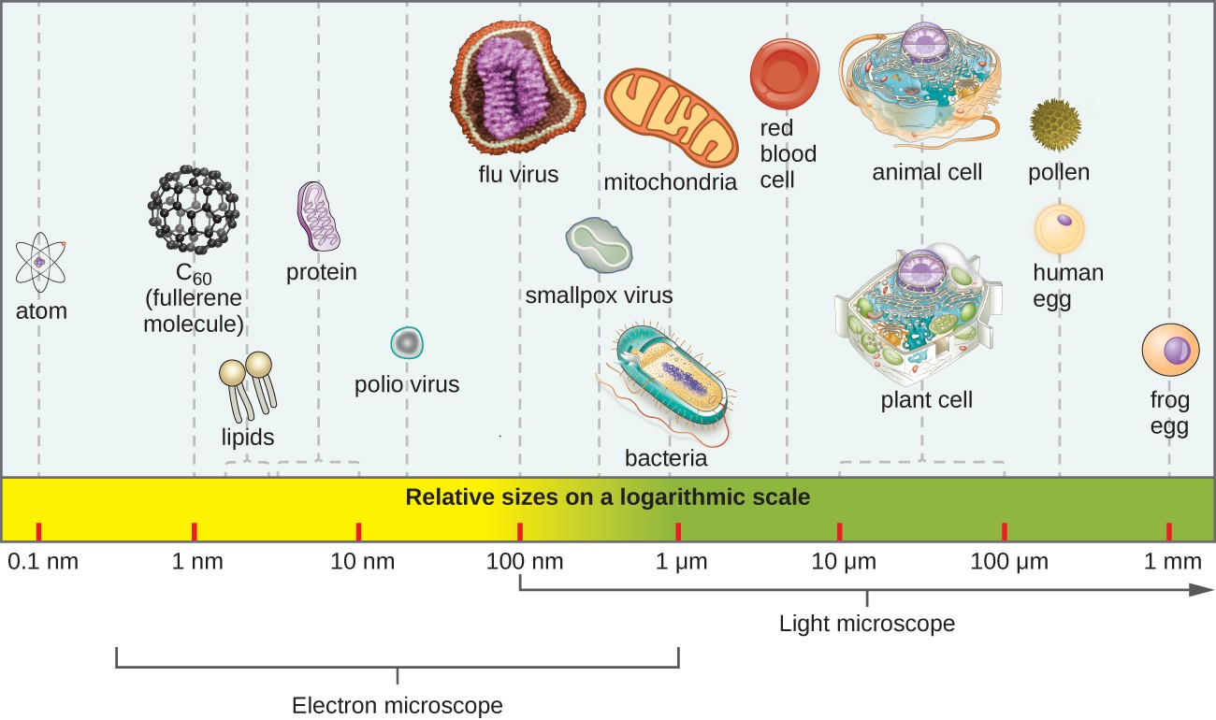
Where are Microorganisms Found?
Present in air, water, soil, food, and inside or outside our bodies.
Some are helpful, while others can cause dangerous diseases.

Slide 4
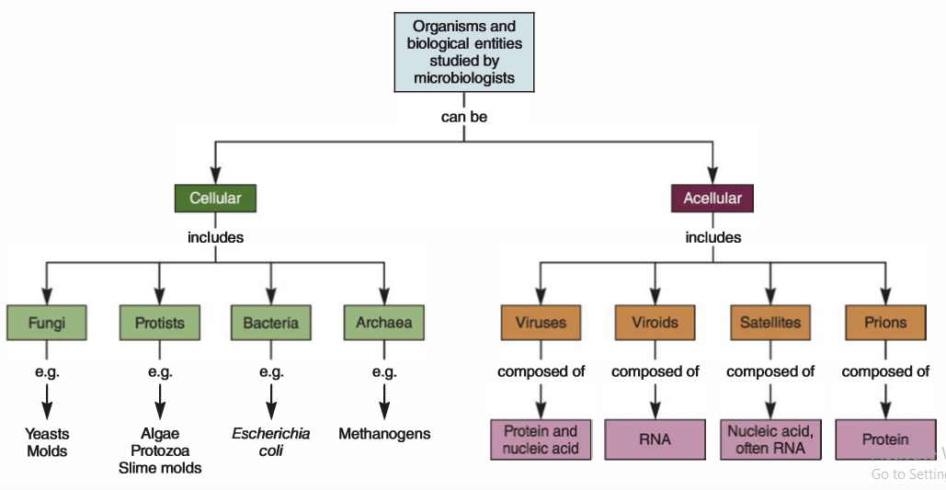
Classification of Microorganisms
Microbes are classified into five major groups:
Bacteria
Algae
Fungi
Protozoa
Viruses

Slide 5
Bacteria
Single-celled organisms that vary in shape: cocci (spherical), bacilli (rod-shaped), spirilla (spiral), vibrios (comma-shaped).
Some are autotrophic (photosynthetic); most are heterotrophic.
Uses of Bacteria:
Fix nitrogen
Make curd/yogurt
Aid digestion
Produce antibiotics
Diseases Caused:
Cholera, Typhoid, Tuberculosis

Slide 6
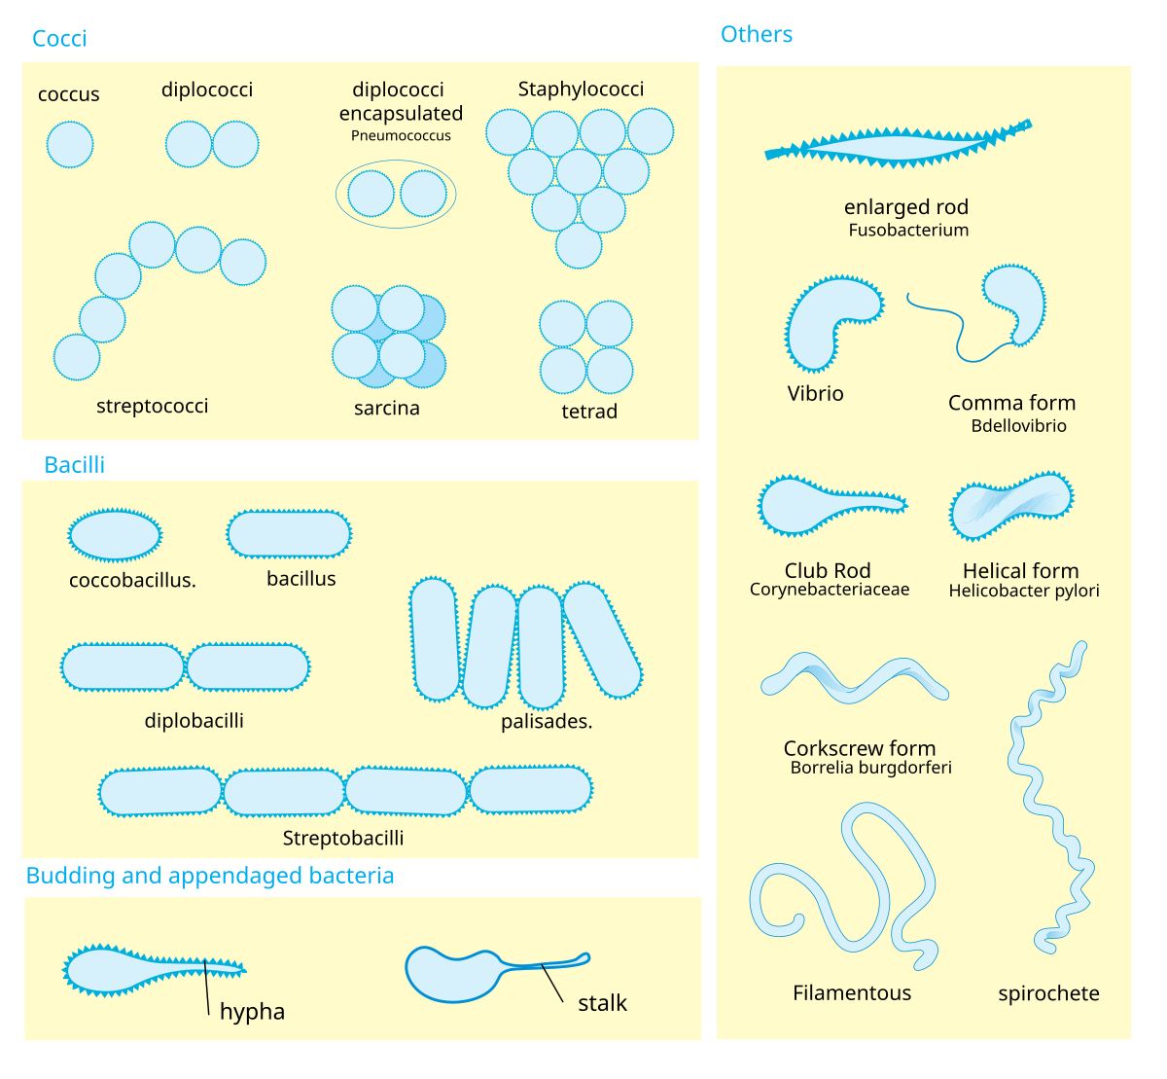

Slide 7
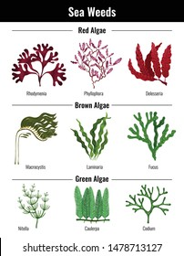
Algae
Autotrophic, aquatic organisms.
Can be unicellular (Chlamydomonas) or filamentous (Spirogyra).
Commonly found in ponds, lakes, and rivers.
Also called "grass of water".
Examples:
Chlamydomonas, Spirogyra, Ulothrix
Uses:
Some algae (e.g. red/brown algae) are used to make jelly-like substances like agar.

Slide 8
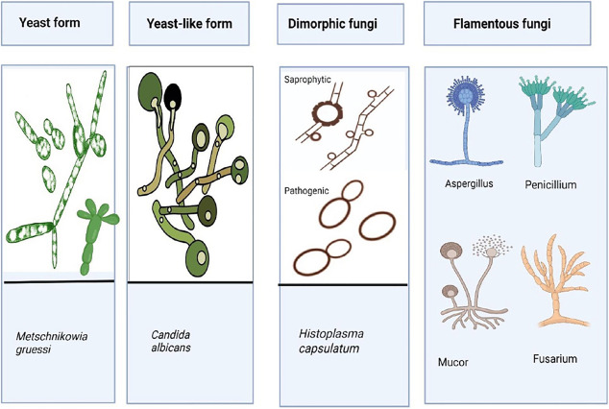
Fungi
Plant-like organisms, heterotrophic (saprophytic or parasitic).
Found on bread, leather, cotton, paper.
Reproduce via spores.
Examples:
Yeast (used in baking)
Aspergillus, Mushrooms, Penicillium
Uses:
Fermentation of bread and alcohol
Production of antibiotics (e.g. Penicillin from Penicillium)

Slide 9
Protozoa
Unicellular, animal-like microbes.
Found in water and soil.
Some are parasites, e.g. Plasmodium (causes malaria), Entamoeba.
Examples:
Amoeba, Paramecium, Giardia, Trypanosoma
Diseases Caused:
Malaria, Amoebiasis

Slide 10
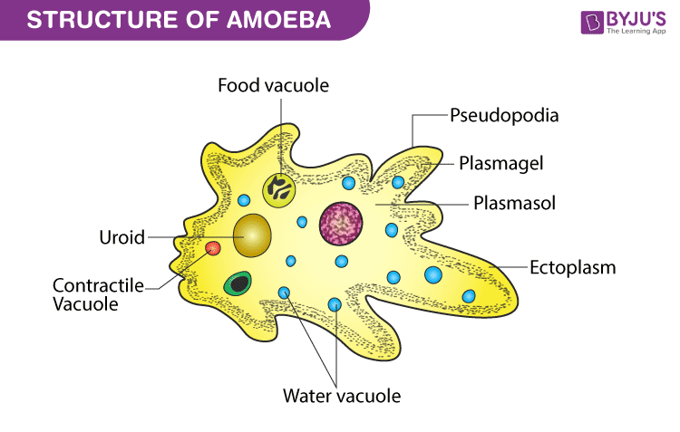
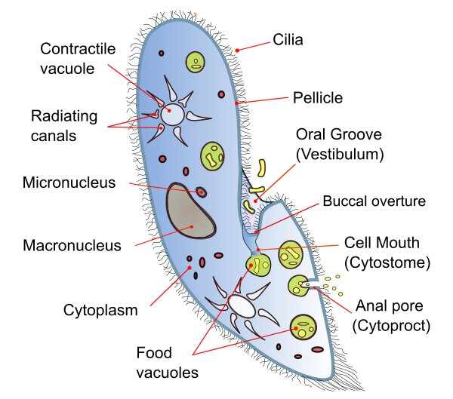

Slide 11
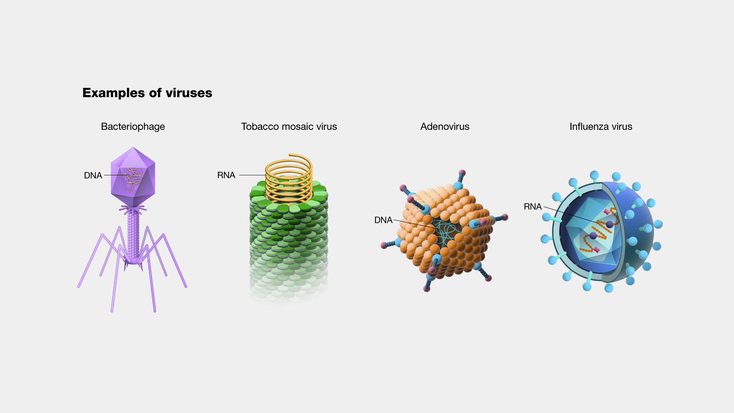
Viruses
Exhibit both living and non-living characteristics.
Can only reproduce inside a living cell.
Cause many diseases in plants, animals, and humans.
Examples:
Polio Virus, HIV, Influenza Virus, Tobacco Mosaic Virus
Diseases Caused:
Cold, Influenza, Polio, COVID-19, AIDS

Slide 12
Useful Microorganisms
Aid in digestion (gut bacteria)
Help in food production (curd, cheese, vinegar, bread, alcohol)
Produce antibiotics and vitamins
Used in nitrogen fixation
Algae used in manufacturing, biofuels

Slide 13
Type | Microorganism | Use/Application | Domain
Bacteria | Lactobacillus | Converts milk to curd | Food industry
Bacteria | Acetobacter aceti | Produces acetic acid (vinegar) | Food industry
Bacteria | Rhizobium | Nitrogen fixation in legume roots | Agriculture
Bacteria | Nitrosomonas, Nitrobacter | Convert ammonia to nitrates (nitrification) | Nitrogen cycle
Bacteria | Escherichia coli (lab strain) | Produces insulin, vaccines using recombinant DNA technology | Biotechnology, medicine
Bacteria | Streptomyces | Produces antibiotics like streptomycin | Pharmaceutical industry
Bacteria | Bacillus thuringiensis (Bt) | Produces insecticidal proteins (used in GM crops) | Agriculture, biotechnology
Bacteria | Clostridium butylicum | Produces butyric acid | Chemical industry
Bacteria | Pseudomonas putida | Cleans oil spills (bioremediation) | Environmental cleanup
Bacteria | Azotobacter | Free-living nitrogen fixation | Soil enrichment
Bacteria | Anabaena | Nitrogen-fixing cyanobacterium | Soil enrichment, water bodies
Fungi | Saccharomyces cerevisiae | Fermentation (bread, alcohol production) | Food and beverage industry
Fungi | Penicillium notatum | Produces antibiotic penicillin | Medicine
Fungi | Aspergillus niger | Produces citric acid | Food additives industry
Fungi | Trichoderma spp. | Biocontrol agent against plant pathogens | Organic farming
Fungi | Mushroom (Agaricus) | Edible fungus, rich in protein | Food/nutrition
Algae | Spirulina | High-protein supplement (single-cell protein) | Health/nutrition
Algae | Chlorella | Used in dietary supplements and oxygen production | Food and environment
Algae | Nostoc | Nitrogen fixation | Agriculture
Algae | Gelidium (red algae) | Produces agar used in labs and food | Research, food industry
Algae | Laminaria (brown algae) | Source of iodine and alginates | Food and cosmetic industry
Protozoa | Entamoeba coli (non-pathogenic) | Helps in digestion (commensal organism) | Human digestion
Protozoa | Plasmodium (research) | Used in vaccine development and genetic studies | Biomedical research
Virus | Bacteriophage | Used in gene therapy, phage therapy | Medicine, biotechnology
Virus | Engineered viral vectors | Used to deliver genes in gene therapy | Genetic engineering

Slide 14
Harmful Microorganisms
Cause diseases in humans, animals, and plants.
Spoil food, clothes, leather.
Produce toxins in food (food poisoning).
Pathogens – Microbes that cause disease.

Slide 15
Microorganism Type | Disease | Causative Agent | Mode of Transmission | Major Symptoms | Prevention/Control
Protozoa | Malaria | Plasmodium vivax/falciparum | Mosquito bite (Anopheles) | Fever (cyclical), chills, shivering | Mosquito nets, no stagnant water, antimalarial meds
 | Amoebiasis | Entamoeba histolytica | Contaminated water/food | Diarrhea with mucus, abdominal cramps | Boiled water, hygiene
 | Sleeping Sickness | Trypanosoma | Tsetse fly bite | Fever, fatigue, sleep disorder | Insect control, early diagnosis
 | Giardiasis | Giardia intestinalis | Contaminated water | Diarrhea, bloating, nausea | Clean water, sanitation
 | Toxoplasmosis | Toxoplasma gondii | Cat feces, undercooked meat | Flu-like symptoms, dangerous in pregnancy | Proper food hygiene, pet care
 | Leishmaniasis | Leishmania donovani | Sandfly bite | Skin ulcers, fever, weight loss | Vector control
Microorganism Type | Disease | Causative Agent | Mode of Transmission | Major Symptoms | Prevention/Control
Fungi | Ringworm | Trichophyton spp. | Contact with infected skin or surfaces | Red, circular, itchy patches on skin | Personal hygiene, antifungal treatment
 | Athlete's Foot | Tinea pedis | Walking barefoot in moist places | Cracking, itching feet skin | Footwear hygiene, antifungals
 | Candidiasis (oral/genital) | Candida albicans | Overgrowth of body’s own flora | White patches, itching, discomfort | Antifungal medication
 | Aspergillosis | Aspergillus spp. | Inhalation of fungal spores | Cough, respiratory distress (in immunocompromised) | Avoid mold, antifungals
 | Histoplasmosis | Histoplasma capsulatum | Inhalation of spores from bird/bat droppings | Flu-like symptoms, respiratory infection | Protective masks in caves, construction sites

Slide 16
Microorganism Type | Disease | Causative Agent | Mode of Transmission | Major Symptoms | Prevention/Control
Bacteria | Tuberculosis (TB) | Mycobacterium tuberculosis | Airborne droplets (cough, sneeze) | Persistent cough, chest pain, blood in sputum, fever | BCG vaccine, avoid contact, proper ventilation
 | Typhoid | Salmonella typhi | Contaminated food/water | High fever, weakness, stomach pain, rashes | Hygienic food/water, vaccination
 | Cholera | Vibrio cholerae | Contaminated water | Diarrhea, dehydration, vomiting | ORS, clean water, sanitation
 | Plague | Yersinia pestis | Rat flea bite | Fever, swollen lymph nodes, chills | Pest control, hygiene
 | Tetanus | Clostridium tetani | Deep cuts/wounds, contaminated objects | Muscle stiffness, jaw locking (lockjaw) | TT vaccine, wound care
 | Pneumonia | Streptococcus pneumoniae | Droplets, contact | Chest pain, breathing difficulty, fever | Vaccination, hygiene
 | Diphtheria | Corynebacterium diphtheriae | Droplets, close contact | Sore throat, fever, breathing difficulty | DPT vaccine, isolation
 | Leprosy (Hansen’s disease) | Mycobacterium leprae | Prolonged contact | Skin lesions, nerve damage, loss of sensation | MDT therapy, early detection
 | Anthrax | Bacillus anthracis | Contact with infected animals/products | Skin sores, respiratory issues, fever | Vaccination (for at-risk), protective gear
 | Food poisoning | Clostridium botulinum, Salmonella | Contaminated/stale food | Vomiting, cramps, diarrhea | Food hygiene, storage
 | Gonorrhea | Neisseria gonorrhoeae | Sexual contact | Burning urination, discharge, infertility (untreated) | Safe sex practices, antibiotics
 | Syphilis | Treponema pallidum | Sexual contact | Sores, rash, nerve damage | Safe sex practices, early treatment
Microorganism Type | Disease | Causative Agent | Mode of Transmission | Major Symptoms | Prevention/Control
Viruses | COVID-19 | SARS-CoV-2 | Airborne, surface contact | Fever, dry cough, fatigue, breathing difficulty | Vaccination, masks, hygiene
 | Influenza (Flu) | Influenza virus | Airborne droplets | Fever, chills, body ache | Flu shot, hygiene
 | Measles | Measles virus | Droplets, direct contact | Rashes, cough, fever | MMR vaccine
 | Mumps | Mumps virus | Droplets, saliva | Swollen glands, pain, fever | MMR vaccine
 | Rubella (German measles) | Rubella virus | Droplets | Mild fever, rash | MMR vaccine
 | Polio | Poliovirus | Contaminated water/food | Paralysis, fever, muscle pain | Polio vaccine (OPV/IPV)
 | Hepatitis A | Hepatitis A virus | Contaminated food/water | Jaundice, nausea, fatigue | Vaccination, hygiene
 | Hepatitis B | Hepatitis B virus | Body fluids, blood | Liver damage, yellow skin/eyes | HBV vaccine, avoid needle sharing
 | AIDS | HIV (Human Immunodeficiency Virus) | Blood, sexual contact, mother to baby | Weak immunity, infections | Safe sex, no shared needles, ART
 | Rabies | Rabies virus | Bite of infected animal (e.g. dog) | Hydrophobia, paralysis, coma | Rabies vaccine, post-bite treatment
 | Dengue | Dengue virus | Mosquito bite (Aedes aegypti) | Fever, joint pain, rash | Mosquito control, no stagnant water
 | Chickenpox | Varicella-zoster virus | Airborne, direct contact | Itchy blisters, fever | Chickenpox vaccine
 | Smallpox (eradicated) | Variola virus | Droplets, contact | High fever, pus-filled sores | (Eradicated via global vaccination)

Slide 17
Communicable Diseases
Definition: Diseases that spread from one person to another through air, water, food, contact, or vectors (insects).
Examples:
Tuberculosis (air)
Cholera (water)
Typhoid (food)
Malaria (mosquito)

Slide 18
Prevention of Communicable Diseases
Vaccination
Hygiene and sanitation
Proper waste disposal
Boiling water
Avoiding contact with infected persons
Term: Vaccine – A substance that stimulates the immune system to develop immunity against specific diseases.
Examples of Vaccines:
BCG (Tuberculosis)
Oral Polio Vaccine
MMR (Measles, Mumps, Rubella)

Slide 19
Food Spoilage by Microbes
Causes:
Microbial growth changes taste, smell, color, and texture of food.
Signs of Spoilage:
Foul smell
Discoloration
Gas formation
Sliminess
(Faster in warm and moist conditions)

Slide 20
Food Preservation Techniques
Why Needed: To prevent spoilage, food wastage, and foodborne diseases.
Methods of Preservation:
Chemical preservatives (e.g., sodium benzoate, potassium metabisulphite)
Pasteurization (milk)
Refrigeration and freezing
Vacuum packing
Drying
Canning and bottling
Salting and pickling

Slide 21
Nitrogen Fixation and Nitrogen Cycle
Microbes like Rhizobium and cyanobacteria (blue-green algae) fix atmospheric nitrogen.
Maintain nitrogen balance in nature.
Nitrogen Cycle Stages:
Nitrogen fixation (bacteria)
Nitrification
Assimilation (plants absorb nitrates)
Ammonification (from dead organisms)
Denitrification (back to atmosphere)

Slide 22
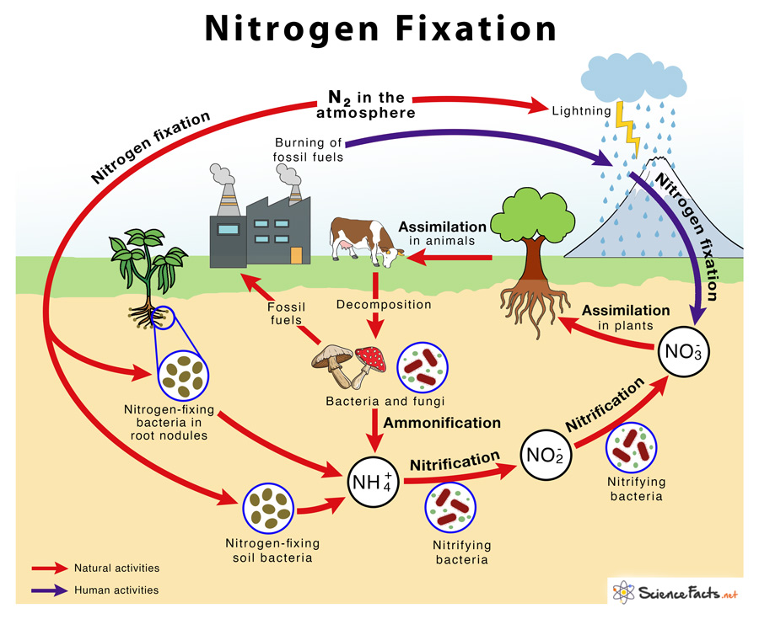

Slide 23
Antibiotics and Antiseptics
Antibiotics – Substances produced by microbes that kill/inhibit harmful bacteria.
Example: Penicillin from Penicillium notatum
Antiseptics – Chemicals applied to the skin to kill germs.
Example: Dettol, iodine
Caution: Overuse or misuse of antibiotics leads to resistance.

Slide 24
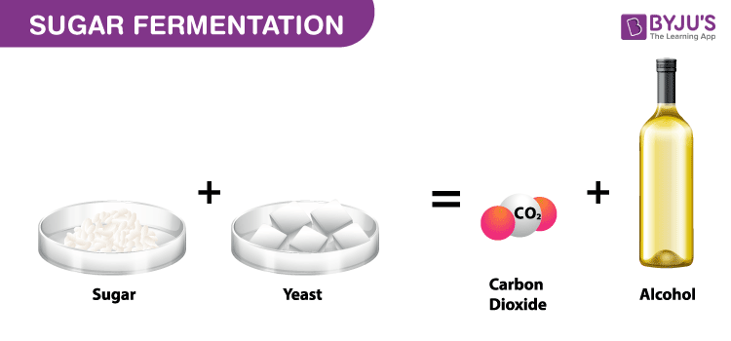
Fermentation by Microorganisms
Yeast is used in alcohol production and bread rising (releases CO₂).

Slide 25
Role in Environment and Biotechnology
Decomposers – Fungi and bacteria break down dead matter.
Oil-eating bacteria – Clean oil spills.
Used in biotechnology to produce insulin, hormones, vaccines.

Slide 26
THANKS

